Slide 1
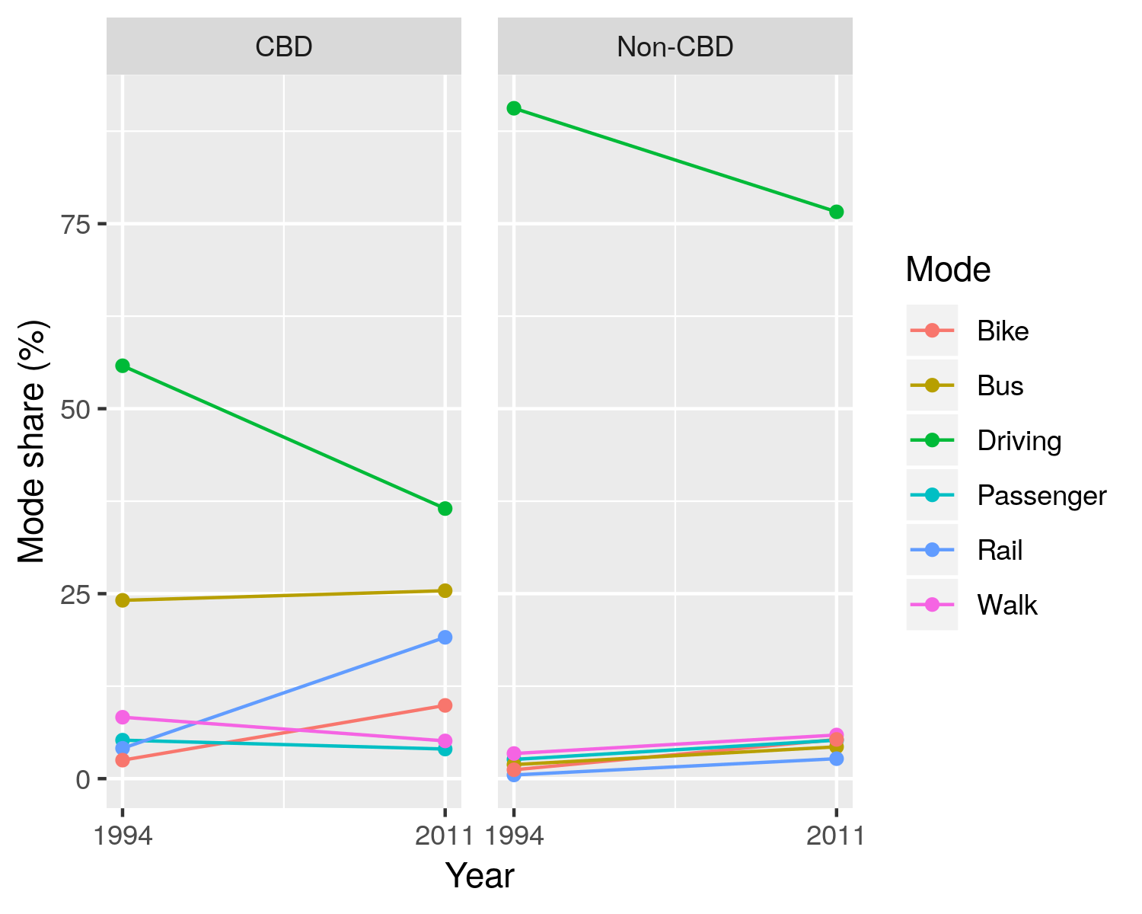
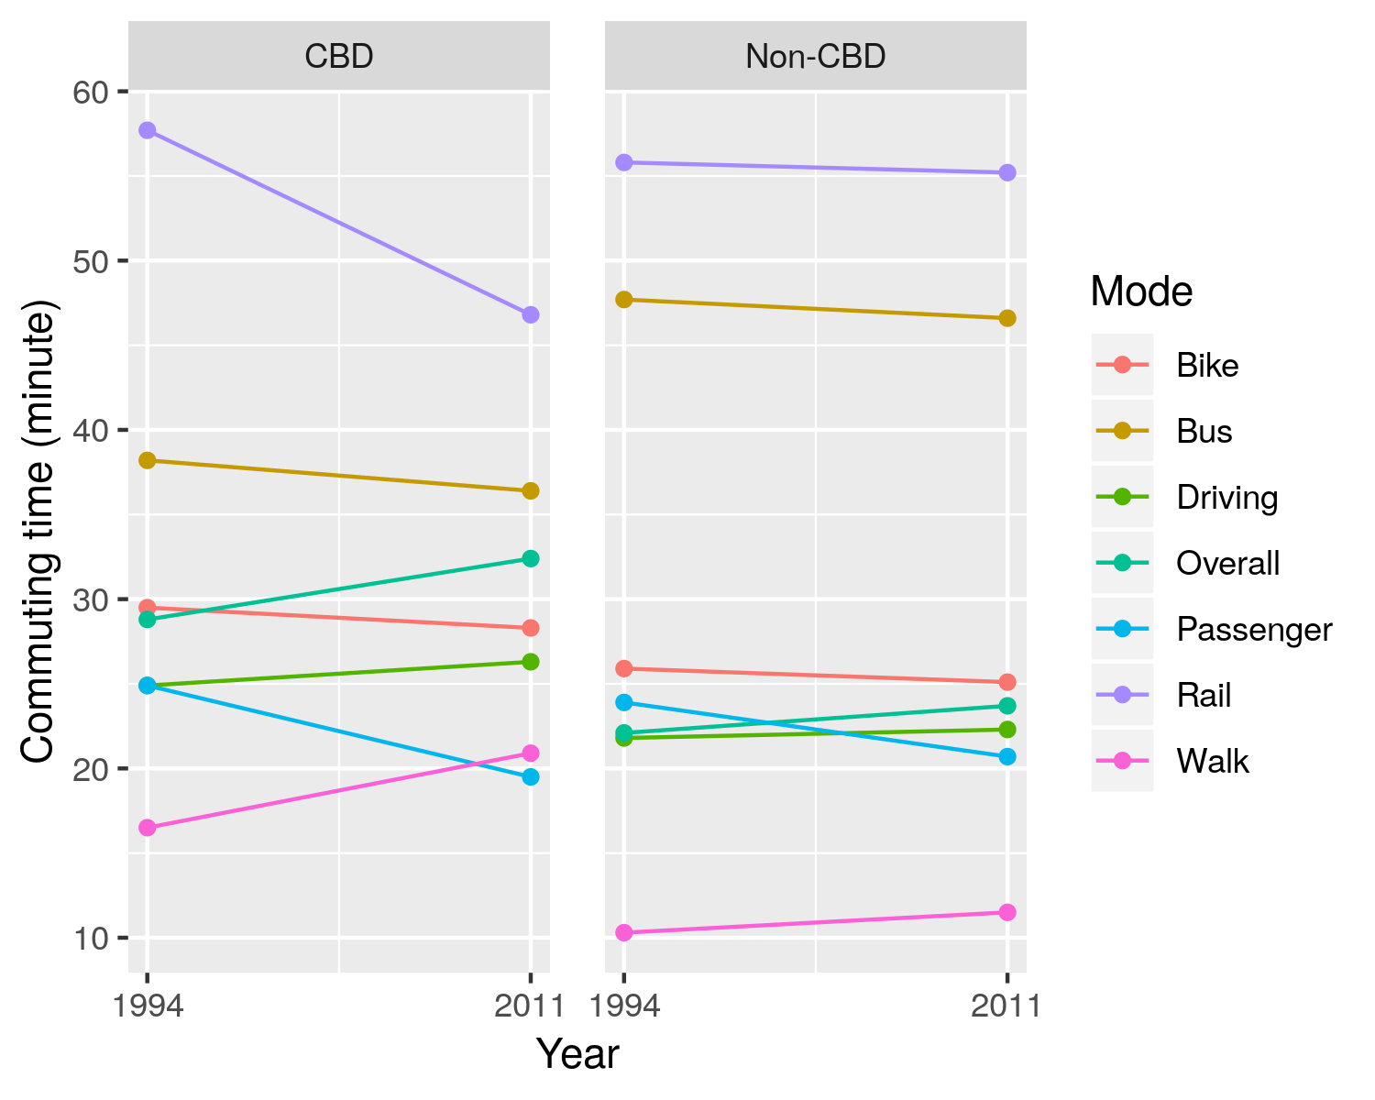
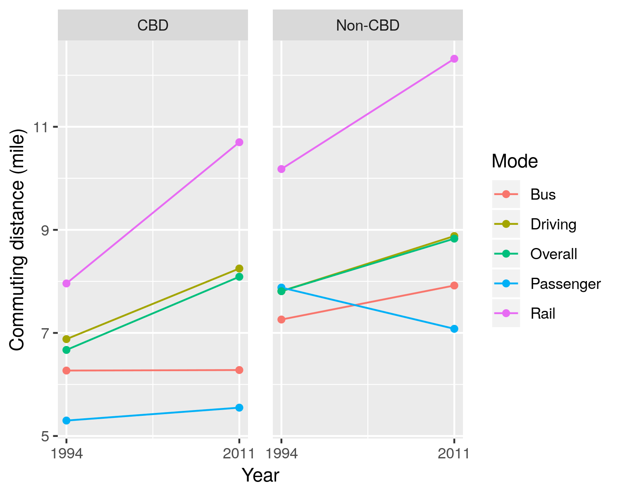
Testing the Constant Commuting Time Hypothesis amid Substantial Changes to Transportation
and Land Use: A Case Study of Portland, OR 1994-2011
Huajie Yang ; Liming Wang, Ph.D.
Toulan School of Urban Studies and Planning, Portland State University
Paper No. 19-02447
ABSTRACT
There have been numerous of theoretical and empirical transportation research contesting the stability of travel time commuting time over time. The constant travel commuting time budget hypothesis posits that people adjust trip frequencies and duration, routes, shift across modes, and locators sort through locations so that their travel time is within a constant budget limit. There is a discrepancy between studies applying aggregate nationwide analysis and those with disaggregate case analysis and difference in data collection may have contributed to different conclusions reported in the literature. This study conducts both aggregate and disaggregate analyses with two travel surveys of the Portland region conducted in 1994 and 2011, respectively. We employ descriptive analysis and t-tests to compare aggregate commuting time between the two years and estimate regression models to explore factors affecting disaggregate commuting time at the individual trip-level. Another question of particular interest is: does commuting time remain stable after transportation and land use system go through substantial changes like Portland, OR between 1994 and 2011?
Our study indicates that average commuting time, along with average commuting distance, has increased slightly from 1994 to 2011, as the mode share has shifted away from driving during this period. The growth in shares of non-driving modes, the speed of which are slower than driving, coupled with increased travel distance, contributes to the small increase in average commuting time. Our analysis also indicates that average travel speed has improved for transit riders, as well as drivers, contradicting early research that claims public transit investment has worsened congestion in Portland.
Mode Share
Driving is still the dominant mode for both CBD and non-CBD trips, but driving mode share decreased from 1994 to 2011.
For CBD trips, the total mode share of bus and rail is more than 44 percent in 2011, which is much higher than the mode share of driving.
The case of Portland shows investment in transit can reduce private vehicle dependence and transit can be the dominant mode.
Commuting Time
The t-test shows that the changes in commuting time by mode are insignificant except the changes in commuting time of passenger CBD trips, but the changes in overall commuting time is significant.
We use mode share as weight to aggregate average commuting time, shown in TABLE 2. Only the average commuting time weighted by mode share of driving trips decreased, and the average commuting time weighted by mode share of trips by all other modes increased. The growth in shares of non-driving modes, coupled with longer average travel time of non-driving modes contributes to the small increase in average commuting time.
Figure 1. Weighted mode share for HBW trips by mode and area
Figure 3. Weighted average HBW trip travel time by mode and area
TABLE 2. Commuting time (in minutes) and mode share
Commuting Distance
Mode | 1994 average travel time | 2011 average travel time | 1994 mode share (%) | 2011 mode share (%) | 1994 Travel time weighted by mode share | 2011 Travel time weighted by mode share | % change
Driving | 22.0 | 22.6 | 86.9 | 71.7 | 19.109 | 16.182 | -15.3
Passenger | 24.1 | 20.6 | 2.8 | 5.1 | 0.687 | 1.043 | 51.9
Bus | 42.0 | 41.9 | 4.2 | 6.9 | 1.766 | 2.881 | 63.1
Rail | 56.8 | 51.0 | 0.8 | 4.7 | 0.475 | 2.417 | 408.5
Walk | 11.7 | 12.6 | 3.9 | 5.8 | 0.454 | 0.724 | 59.4
Bike | 26.6 | 25.8 | 1.3 | 5.9 | 0.350 | 1.513 | 332.1
Motivation
Mixed results of empirical studies on constant commuting time hypothesis
Incomparable data sources due to evolution of data collection method
Aggregate and disaggregate analysis
Substantial changes
land use system
sociodemographic profile
transportation system, especially the extensive light rail network
The growth rate of commuting distance is lower than that of commuting time.
Suburbanization leads to increase in travel distance, but travel time does not grow in proportion because of increase in speed.
The travel distance of CBD rail trips increased by 34.48 percent, while the travel distance of CBD bus trips increased slightly, confirming commuters’ preference for rail over bus for long trips.
Disaggregate analysis
As shown in the TABLE 3, the trip attributes and sociodemographic variables explain more than 60 percent variation in commuting time. The effect of trip-related and socioeconomic characteristics on commuting time are significantly different between 1994 and 2011. The interaction term between a mode and distance represents the average speed of the mode. For example, the coefficient for the interaction term between driving mode and distance is 1.52. This means it takes 1.52 minutes to drive one mile.
Data
Two comparable travel survey:
1994 Portland Activity Survey
2011 Oregon Household Activity Survey
Linked commuting trips
10,366 linked commuting trips: 3476 from 1994 survey; 6890 from 2011 survey
Six modes: driving, passenger, bus, rail, walk, bike
CBD vs Non-CBD commuting trips
If a trip has either its origin or destination Transportation Analysis Zone (TAZ ) located in CBD area, it is identified as a CBD commuting trip; otherwise a non-CBD trip.
TABLE 3. Selected coefficients of regression models
Figure 2. Average commuting distance by mode and area
Variable | Pooled | 1994 CBD | 1994 non-CBD | 2011 CBD | 2011 non-CBD
ModePassenger:distance | 1.690*** (0.080) | 2.870*** (0.680) | 2.430*** (0.220) | 2.200*** (0.476) | 1.540*** (0.086)
ModeBIKE:distance | 6.610*** (0.227) | 8.950*** (1.790) | 9.410*** (0.740) | 5.460*** (0.861) | 6.35*** (0.243)
ModeBus:distance | 2.420*** (0.083) | 2.410*** (0.239) | 3.370*** (0.279) | 2.110*** (0.165) | 2.100*** (0.119)
ModeDriving:distance | 1.520*** (0.016) | 1.860*** (0.155) | 1.800*** (0.028) | 1.120*** (0.105) | 1.400*** (0.019)
ModeRail:distance | 1.730*** (0.074) | 0.959** (0.446) | 1.600** (0.711) | 1.500*** (0.137) | 1.800*** (0.096)
ModeWalk:distance | 20.800*** (0.967) | 31.000*** (5.320) | 32.200*** (2.560) | 20.900*** (2.940) | 18.500*** (1.250)
Constant | 12.600*** (1.170) | 11.700* (6.540) | 6.610** (2.870) | 15.800** (7.920) | 10.500*** (1.350)
Observations | 10.366 | 500 | 2,976 | 1,068 | 5.822
Adjusted R² | 0.670 | 0.607 | 0.678 | 0.610 | 0.691
Trip Distribution
The proportion of CBD trips increased during the period. This seems to indicate the importance of CBD areas as employment center has strengthened from 1994 to 2011, partly because of reverse of the suburbanization trend since the 1990s and the improvement in transit network, particularly the light rail network.
TABLE 1 HBW trip volume by area between 1994 and 2011
Year | Area | Proportion (%)
1994 | CBD | 9.86
 | non-CBD | 90.14
2011 | CBD | 11.89
 | non-CBD | 88.11
Methodology
Aggregate analysis: test the constant commuting time hypothesis by comparing the mean commuting time between 1994 and 2011
travel variables by mode
T-test
Disaggregate analysis: examine factors influencing commuting time
Where
Y - Commuting time
X₁ - Trip-related characteristics: mode, travel distance, peak hours, CBD indicator
X₂ - Sociodemographic variables: income, age, gender, household size, vehicle ownership, race,
Conclusion and Discussion
Commuting time increased from 1994 to 2011 in Portland region. The evidence of analysis does not support stable commuting time hypothesis.
The growth in shares of non-driving modes coupled with longer average travel time of non-driving modes contribute to the increase in commuting time.
Driving speed has increased during the period though there has been a common perception of worsening traffic congestion.
The evidence of the Portland case indicates that continuous investment in transit and bike infrastructure can reduce private vehicle dependence and strengthen the role of CBD as employment center
The trip-related and socioeconomic characteristics explain a large proportion of variance in commuting time, and the effect of trip-related and socioeconomic characteristics on commuting time are significantly different between 1994 and 2011.
TABLE 4 shows the results of Z tests of the differences in mode speed inferred from regression modes. For both the CBD and non-CBD trips in 1994 and 2011, the speed difference between driving trips is significant. This suggests the average driving speed increased though there was perception of worsening traffic congestion over the period.
$$Y= β_{0}+ β_{1}X_{1}+β_{2}X_{2}$$
TABLE 4. Z-test for the speed (miles/hour) difference by mode
Mode | 1994 CBD VS 1994 non-CBD | 2011 CBD VS 2011 non-CBD | 1994 CBD VS 2011 CBD | 1994 non-CBD VS 2011 non-CBD
Driving | 0.99 | -10.64* | 21.17* | 20.18*
Passenger | 3.76 | 11.62 | 6.34 | 2.57*
Bus | -7.14* | 0.17 | 3.46 | 10.60*
Rail | -25.14 | -6.62 | -22.65 | 2.49
Walk | -0.08 | 0.37 | 0.93 | 1.00*
Bike | -0.33 | -1.55 | 4.29 | 4.62*
ACKNOWLEDGEMENTS
We would like to acknowledge partial support from the National Institute for Transportation and Communities (NITC) under grant number (NITC-881).
1

